Slide 1
Algorithm Analysis

Slide 2
Algorithm
An algorithm is a set of instructions to be followed to solve a problem.
There can be more than one solution (more than one algorithm) to solve a given problem.
An algorithm can be implemented using different programming languages on different platforms.
An algorithm must be correct. It should correctly solve the problem.
e.g. For sorting, this means even if (1) the input is already sorted, or (2) it contains repeated elements.
Once we have a correct algorithm for a problem, we have to determine the efficiency of that algorithm.

Slide 3
Algorithmic Performance
There are two aspects of algorithmic performance:
Time
Instructions take time.
How fast does the algorithm perform?
What affects its runtime?
Space
Data structures take space
What kind of data structures can be used?
How does choice of data structure affect the runtime?
We will focus on time:
How to estimate the time required for an algorithm
How to reduce the time required

Slide 4
Algorithmic Performance
Analysis of Algorithms is the area of computer science that provides tools to analyze the efficiency of different methods of solutions.
How do we compare the time efficiency of two algorithms that solve the same problem?

Slide 5
Analysis of Algorithm
Naïve Approach: implement these algorithms in a programming language (C++), and run them to compare their time requirements. Comparing the programs (instead of algorithms) has difficulties.
How are the algorithms coded?
Comparing running times means comparing the implementations.
We should not compare implementations, because they are sensitive to programming style that may could the issue of which algorithm is inherently more efficient.
What computer should we use?
We should compare the efficiency of the algorithms independently of a particular computer
What data should the program use?

Slide 6
Analysis of Algorithm
When we analyze algorithms, we should employ mathematical techniques that analyze algorithms independently of specific implementations, computers, or data.
To analyze algorithms:
First, we start to count the number of significant operations in a particular solution to assess its efficiency.
Then, we will express the efficiency of algorithms using growth functions.

Slide 7
The Execution Time of Algorithms
Each operation in an algorithm (or a program) has a cost.
➔ Each operation takes a certain of time.
count = count + 1; ➔ take a certain amount of time, but it is constant
A sequence of operations:
count = count + 1; Cost: c₁
sum = sum + count; Cost: c₂
➔ Total Cost = c₁ + c₂

Slide 8
The Execution Time of Algorithms(cont.)
Example: Simple If-Statement
Cost Times
if (n < 0) c1 1
absval = -n c2 1
else
absval = n; c3 1
Total Cost <= c1 + max(c2,c3)

Slide 9
The Execution Time of Algorithms(cont.)
Example: Simple Loop
Cost Times
i = 1; c1 1
sum = 0; c2 1
while (i <= n) { c3 n+1
i = i + 1; c4 n
sum = sum + i; c5 n
}
Total Cost = c1 + c2 + (n+1)*c3 + n*c4 + n*c5
➔ The time required for this algorithm is proportional to n

Slide 10
The Execution Time of Algorithms(cont.)
Example: Nested Loop
Cost Times
i=1; c1 1
sum = 0; c2 1
while (i <= n) { c3 n+1
j=1; c4 n
while (j <= n) { c5 n*(n+1)
sum = sum + i; c6 n*n
j = j + 1; } c7 n*n
i = i +1; } c8 n
Total Cost = c1 + c2 + (n+1)*c3 + n*c4 + n*(n+1)*c5+n*n*c6+n*n*c7+n*c8
➔ The time required for this algorithm is proportional to n²

Slide 11
General Rules for Estimation
Loops: The running time of a loop is at most the running time of the statements inside of that loop times the number of iterations.
Nested Loops: Running time of a nested loop containing a statement in the inner most loop is the running time of statement multiplied by the product of the sized of all loops.
Consecutive Statements: Just add the running times of those consecutive statements.
If/Else: Never more than the running time of the test plus the larger of running times of S1 and S2.

Slide 12
Algorithm Growth Rates
We measure an algorithm’s time requirement as a function of the problem size.
Problem size depends on the application: e.g. number of elements in a list for a sorting algorithm, the number disks for towers of hanoi.
So, for instance, we say that (if the problem size is n)
Algorithm A requires 5*n² time units to solve a problem of size n.
Algorithm B requires 7*n time units to solve a problem of size n.
The most important thing to learn is how quickly the algorithm’s time requirement grows as a function of the problem size.
Algorithm A requires time proportional to n².
Algorithm B requires time proportional to n.
An algorithm’s proportional time requirement is known as growth rate.
We can compare the efficiency of two algorithms by comparing their growth rates.

Slide 13
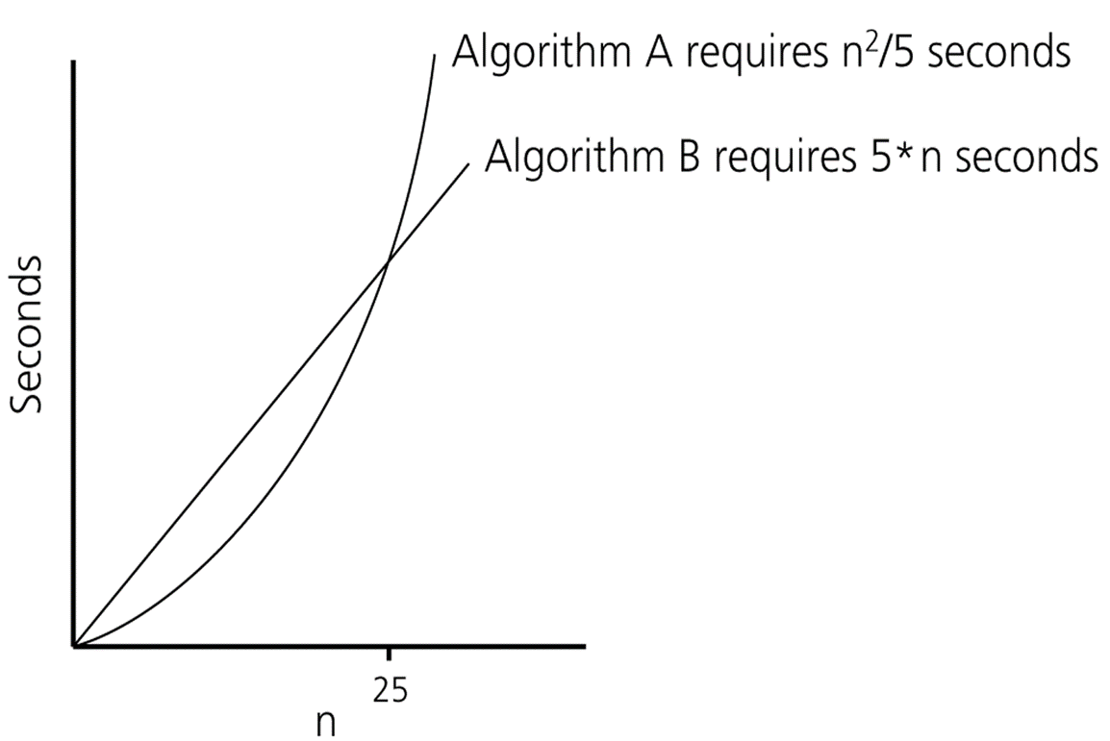
Algorithm Growth Rates
Time requirements as a function
of the problem size n

Slide 14
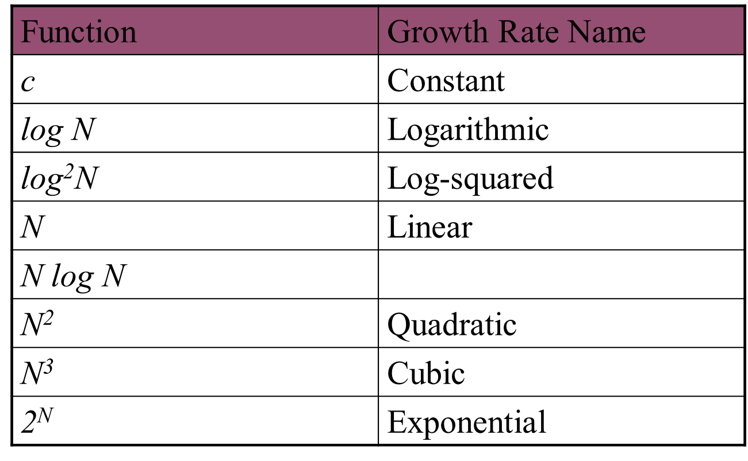
Common Growth Rates

Slide 15
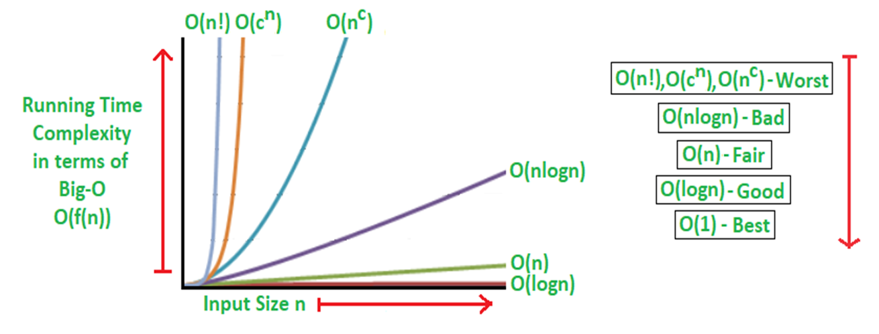
Growth rate comparison

Slide 16
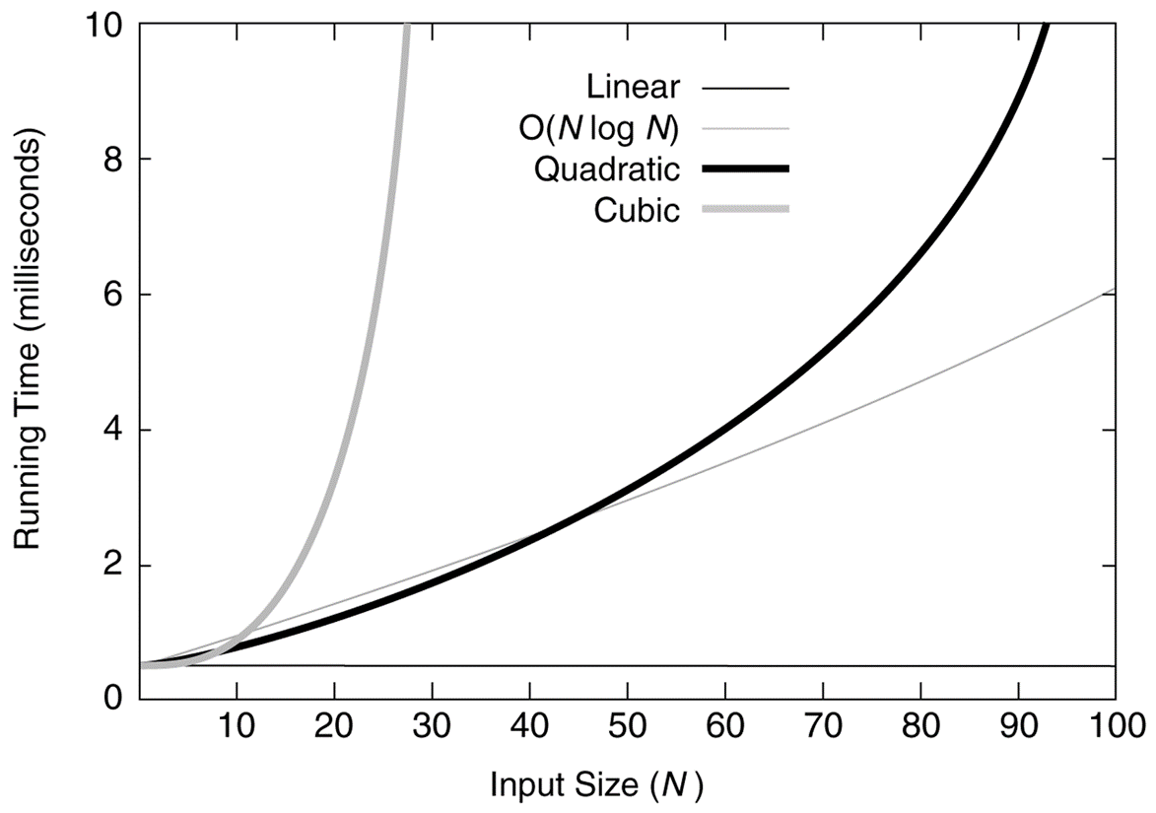
Growth rate comparison
Running times for small inputs

Slide 17
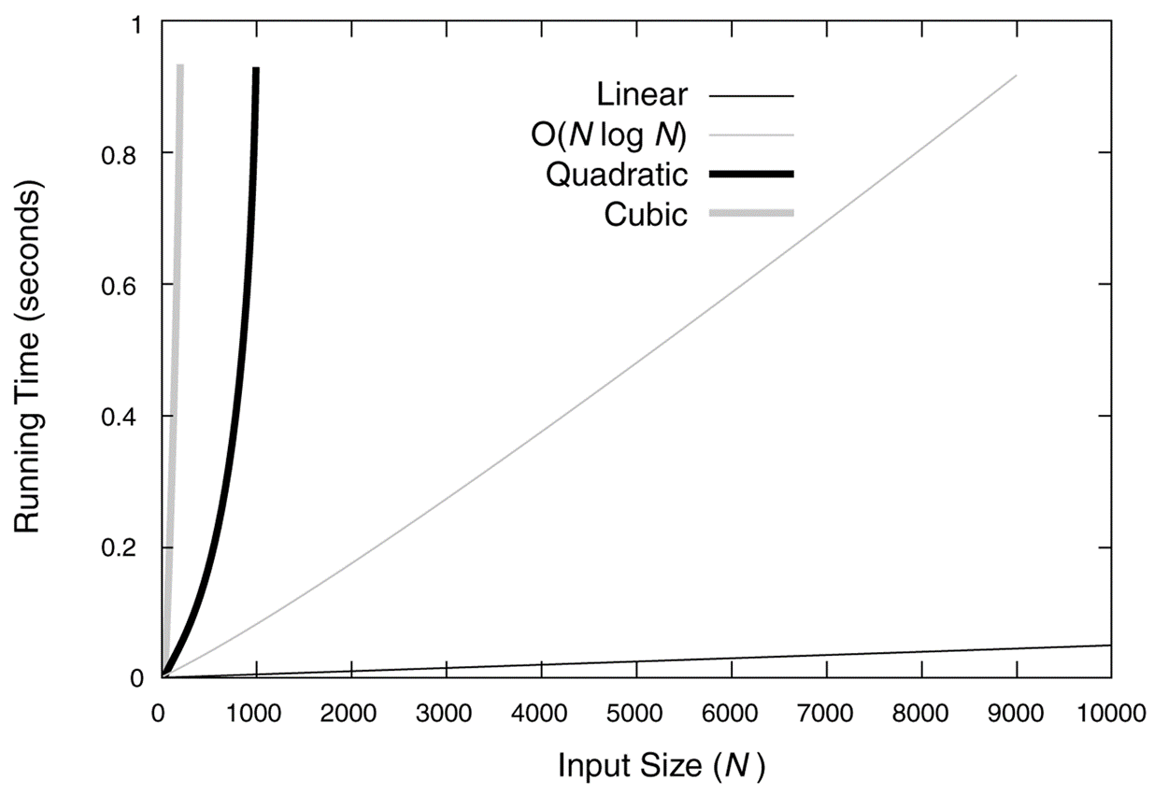
Growth rate comparison
Running times for moderate inputs

Slide 18
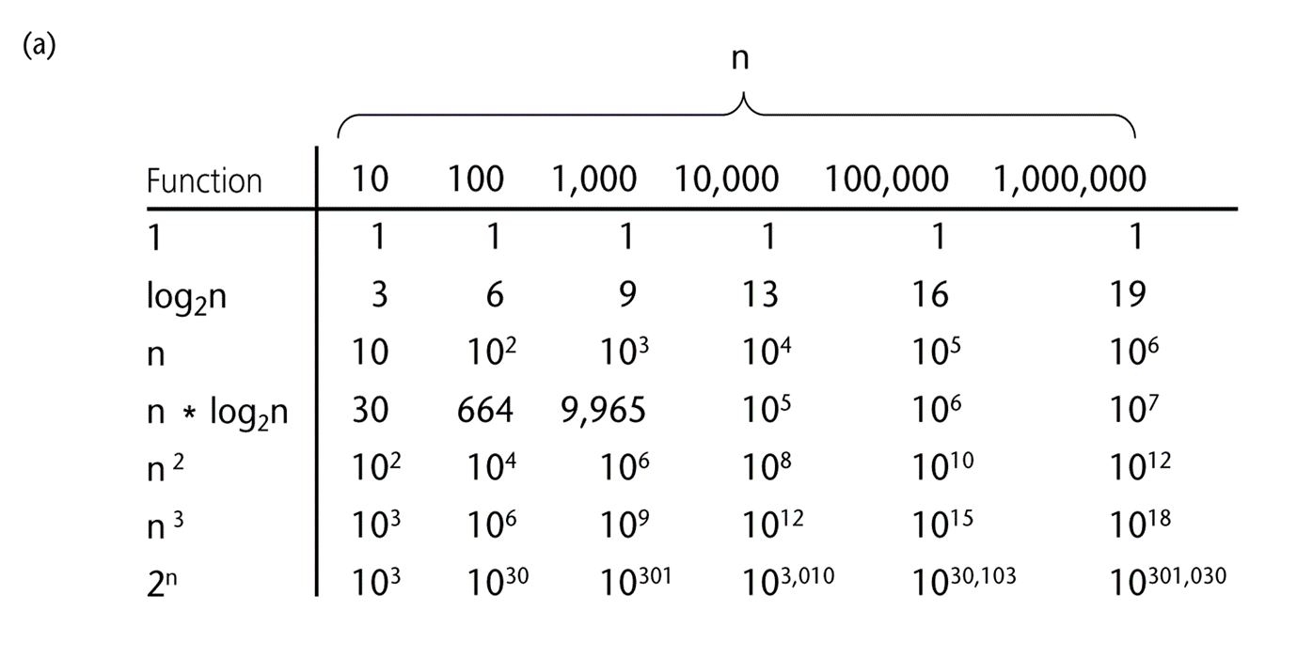
A Comparison of Growth-Rate

Slide 19
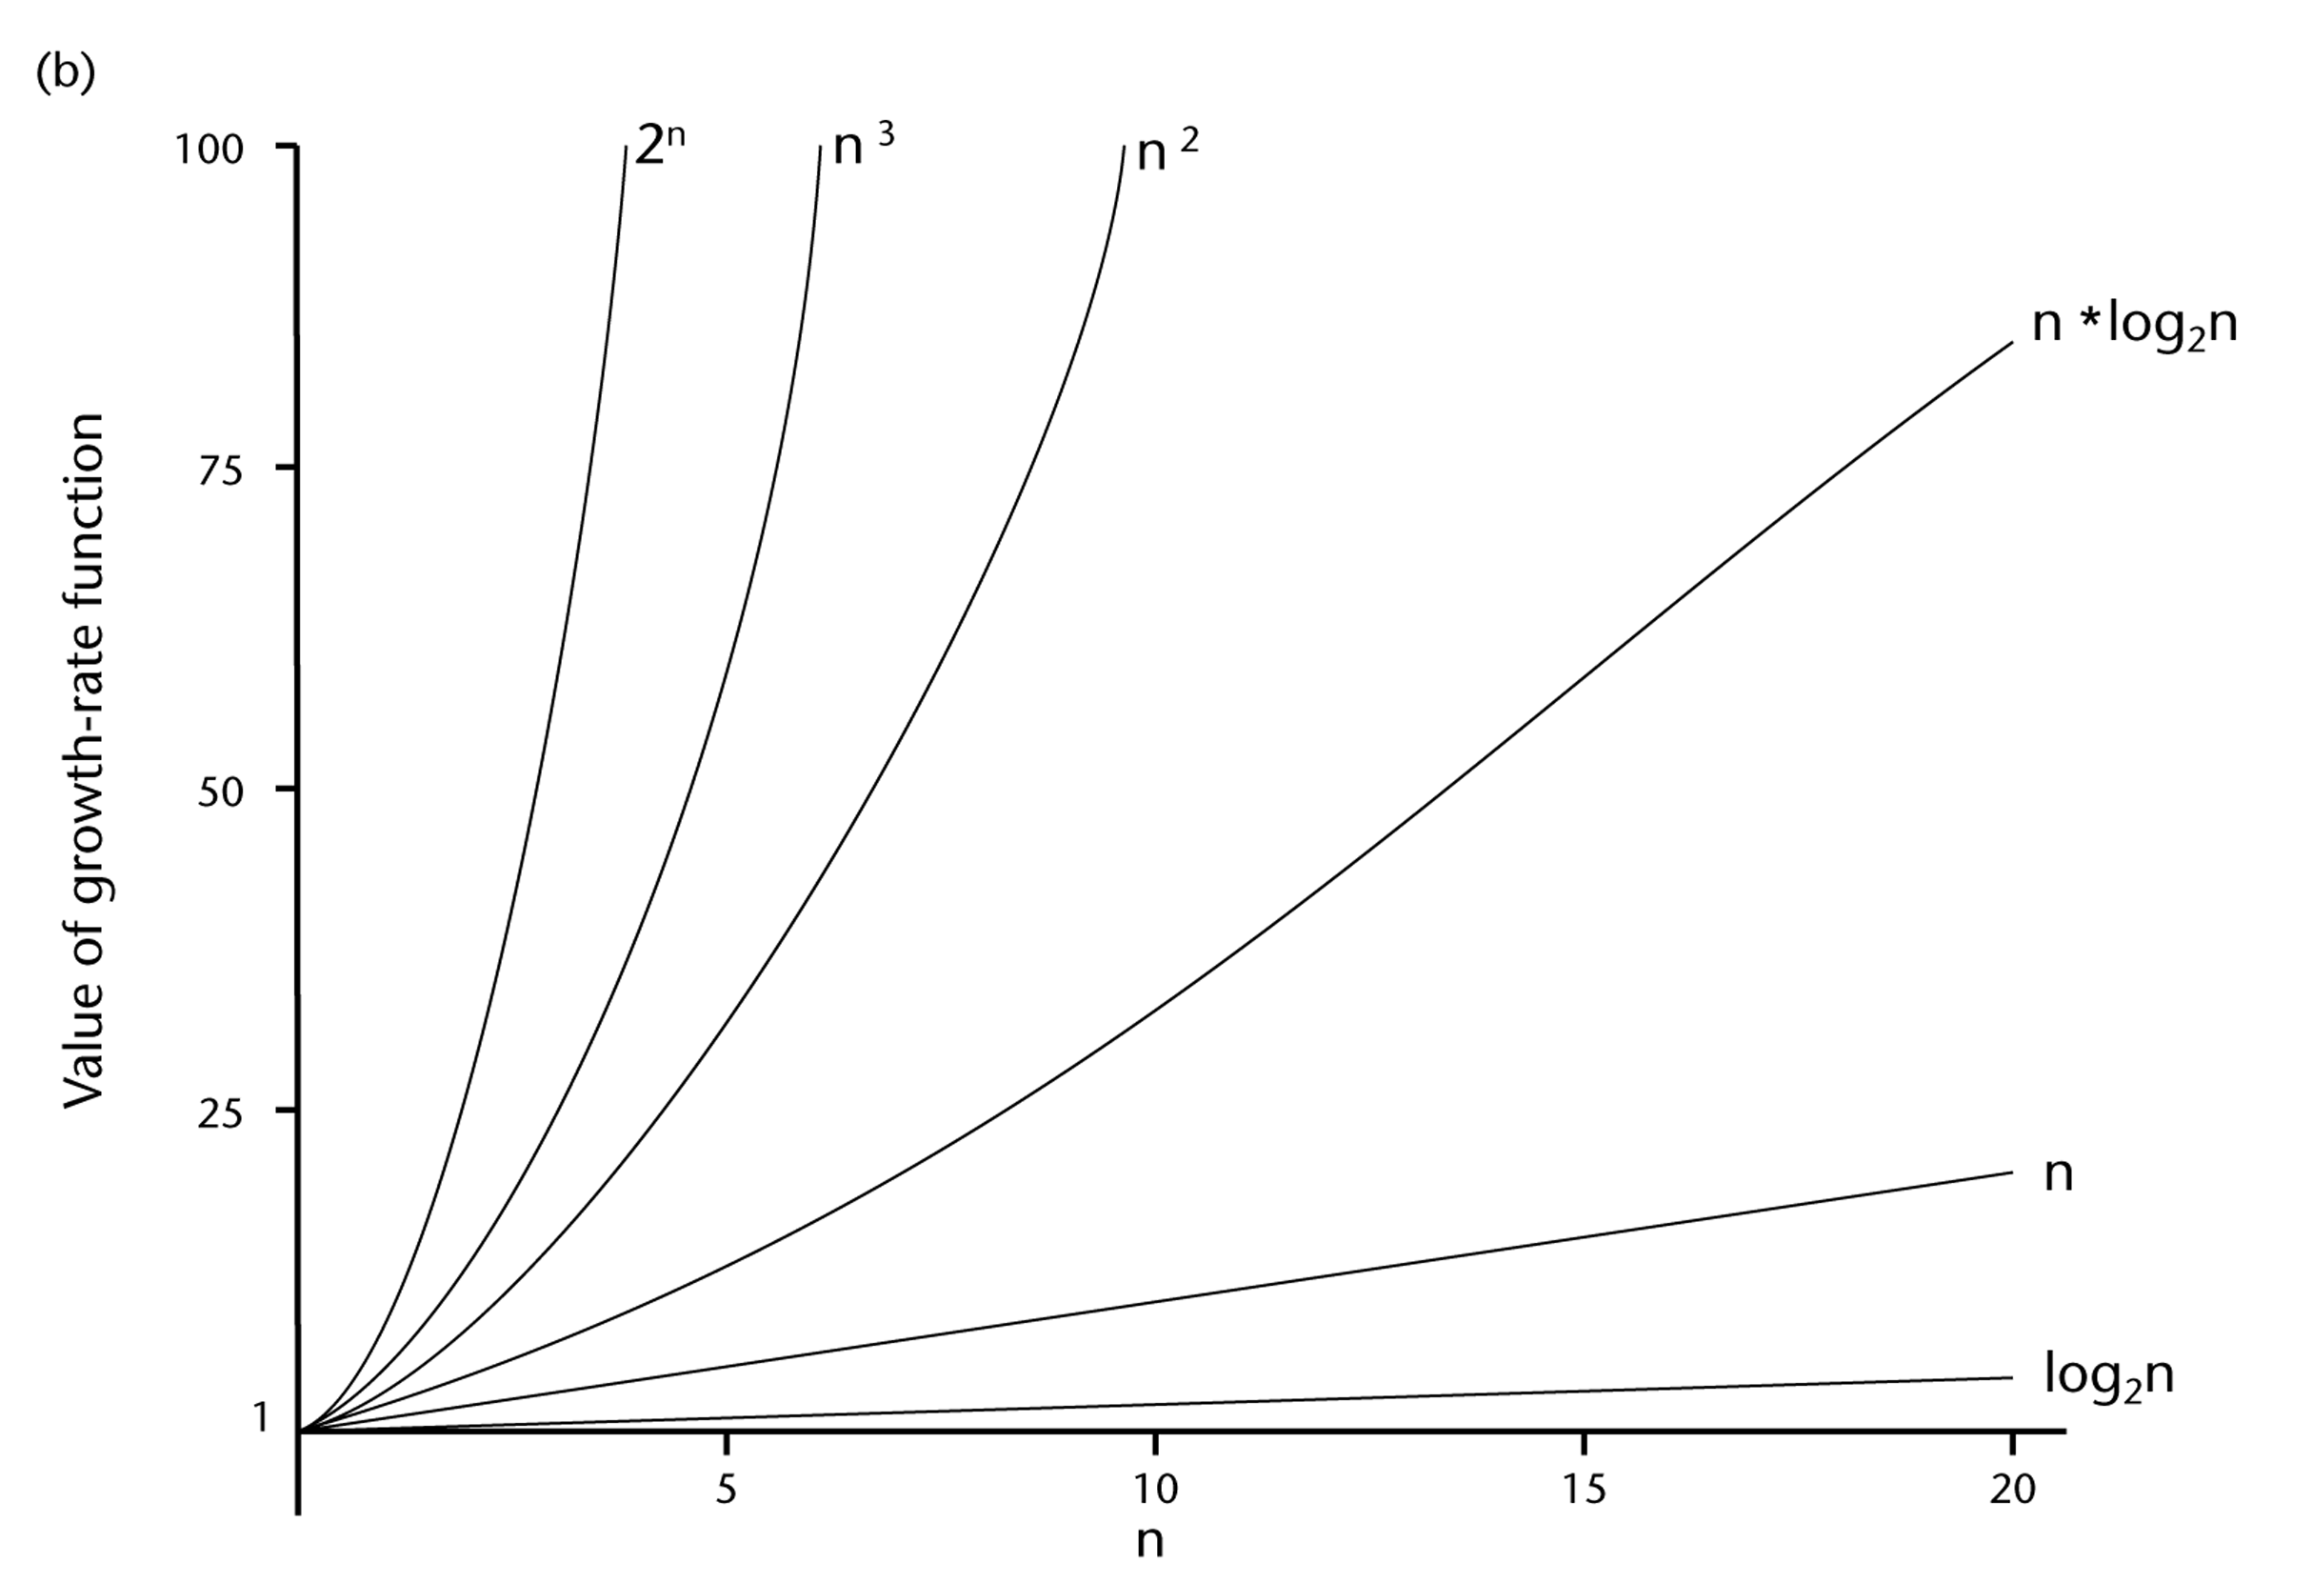

Slide 20
Growth-Rate Functions
O(1) Time requirement is constant, and it is independent of the problem’s size.
O(log₂n) Time requirement for a logarithmic algorithm increases increases slowly
as the problem size increases.
O(n) Time requirement for a linear algorithm increases directly with the size
of the problem.
O(n*log₂n) Time requirement for a n*log₂n algorithm increases more rapidly than
a linear algorithm.
O(n²) Time requirement for a quadratic algorithm increases rapidly with the
size of the problem.
O(n³) Time requirement for a cubic algorithm increases more rapidly with the
size of the problem than the time requirement for a quadratic algorithm.
O(2^{n}) As the size of the problem increases, the time requirement for an
exponential algorithm increases too rapidly to be practical.

Slide 21
Growth-Rate Functions
If an algorithm takes 1 second to run with the problem size 8, what is the time requirement (approximately) for that algorithm with the problem size 16?
If its order is:
O(1) ➔ T(n) = 1 second
O(log₂n) ➔ T(n) = (1*log₂16) / log₂8 = 4/3 seconds
O(n) ➔ T(n) = (1*16) / 8 = 2 seconds
O(n*log₂n) ➔ T(n) = (1*16*log₂16) / 8*log₂8 = 8/3 seconds
O(n²) ➔ T(n) = (1*16²) / 8² = 4 seconds
O(n³) ➔ T(n) = (1*16³) / 8³ = 8 seconds
O(2^{n}) ➔ T(n) = (1*2¹⁶) / 2⁸ = 2⁸ seconds = 256 seconds

Slide 22
Properties of Growth-Rate Functions
We can ignore low-order terms in an algorithm’s growth-rate function.
If an algorithm is O(n³+4n²+3n), it is also O(n³).
We only use the higher-order term as algorithm’s growth-rate function.
We can ignore a multiplicative constant in the higher-order term of an algorithm’s growth-rate function.
If an algorithm is O(5n³), it is also O(n³).
O(f(n)) + O(g(n)) = O(f(n)+g(n))
We can combine growth-rate functions.
If an algorithm is O(n³) + O(4n), it is also O(n³ +4n²) ➔ So, it is O(n³).
Similar rules hold for multiplication.

Slide 23
Properties of Growth-Rate Functions
We can ignore low-order terms in an algorithm’s growth-rate function.
If an algorithm is O(n³+4n²+3n), it is also O(n³).
We only use the higher-order term as algorithm’s growth-rate function.
We can ignore a multiplicative constant in the higher-order term of an algorithm’s growth-rate function.
If an algorithm is O(5n³), it is also O(n³).
O(f(n)) + O(g(n)) = O(f(n)+g(n))
We can combine growth-rate functions.
If an algorithm is O(n³) + O(4n), it is also O(n³ +4n²) ➔ So, it is O(n³).
Similar rules hold for multiplication.

Slide 24
Asymptotic Analysis
Refers to computing the running time of any operation in mathematical units of computation . It is input bound.
If there's no input to the algorithm, it is concluded to work in a constant time

Slide 25
Asymptotic Analysis
Following are the commonly used asymptotic notations to calculate the running time complexity of an algorithm
Big Oh => O()
Big Omega => Ω()
Big Theta => θ()
Other notion are
Little Oh => o()
Little Omega => ω()

Slide 26
Notations
Asymptotic Notations Θ, O, Ω, o, ω
We use Θ to mean “order exactly”,
O to mean “order at most”,
Ω to mean “order at least”,
o to mean “tight upper bound”,
ω to mean “tight lower bound”,
Define a set of functions: which is in practice used to compare two function sizes.

Slide 27
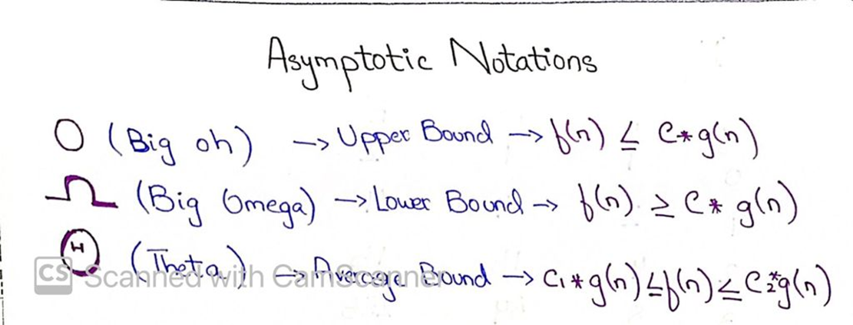
Notation

Slide 28
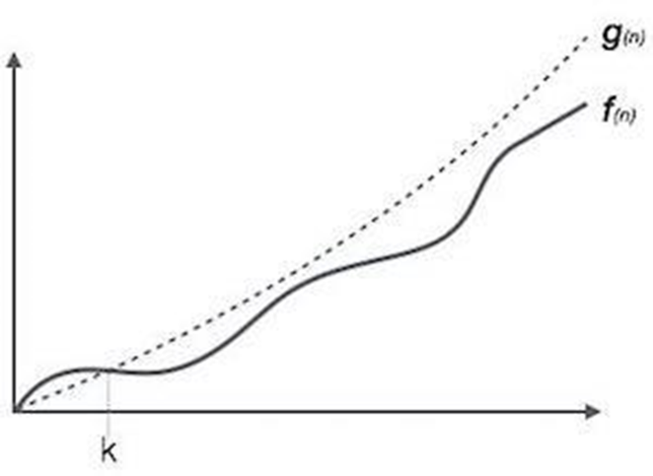
B ig Oh
It measures the worst case time complexity
The longest amount of time an algorithm can possibly take to complete Defines upper bound

Slide 29
Order-of-Magnitude Analysis and Big O Notation
If Algorithm A requires time proportional to f(n), Algorithm A is said to be order f(n), and it is denoted as O(f(n)).
The function f(n) is called the algorithm’s growth-rate function.
Since the capital O is used in the notation, this notation is called the Big O notation.
If Algorithm A requires time proportional to n², it is O(n²).
If Algorithm A requires time proportional to n, it is O(n).

Slide 30
Definition of the Order of an Algorithm
Definition:
Algorithm A is order f(n) – denoted as O(f(n)) – if constants k and n₀ exist such that A requires no more than k*f(n) time units to solve a problem of size n ≥ n₀.
The requirement of n ≥ n₀ in the definition of O(f(n)) formalizes the notion of sufficiently large problems.
In general, many values of k and n can satisfy this definition.

Slide 31
Order of an Algorithm
If an algorithm requires n²–3*n+10 seconds to solve a problem size n. If constants k and n₀ exist such that
k*n² > n²–3*n+10 for all n ≥ n₀ .
the algorithm is order n² (In fact, k is 3 and n₀ is 2)
3*n² > n²–3*n+10 for all n ≥ 2 .
Thus, the algorithm requires no more than k*n² time units for n ≥ n₀ ,
So it is O(n²)

Slide 32
Example- Sequential Search
insequentialSearch(const int a[], int item, int n){
for (int i = 0; i < n && a[i]!= item; i++);
if (i == n)
return –1;
return i;
}
Unsuccessful Search: ➔ O(n)
Successful Search:
Best-Case: item is in the first location of the array ➔O(1)
Worst-Case: item is in the last location of the array ➔O(n)
Average-Case: The number of key comparisons 1, 2, ..., n
➔ O(n)
32

Slide 33
Example-Binary Search
At Iteration 1,Length of array = n
At Iteration 2,Length of array = ^{n}⁄₂
At Iteration 3,Length of array = ^{(n⁄}₂⁾⁄₂ = ^{n}⁄₂²
Therefore, after Iteration k, Length of array = ^{n}⁄₂^{k}
Also, we know that after k divisions, the length of array becomes 1
Therefore Length of array = ^{n}⁄₂^{k} = 1 => n = 2^{k}
Applying log function on both sides:=>
log₂ (n) = log₂ (2^{k}) => log₂ (n) = k log₂ (2)
As (log_{a} (a) = 1)
Therefore,=> k = log₂ (n)
Hence, the time complexity of Binary Search is log₂ (n)

Slide 34
Binary Search-Analysis
For an unsuccessful search:
The number of iterations in the loop is ⎣log₂n⎦ + 1
➔ O(log₂n)
For a successful search:
Best-Case: The number of iterations is 1. ➔ O(1)
Worst-Case: The number of iterations is ⎣log₂n⎦ +1 ➔ O(log₂n)
Average-Case: The avg. # of iterations < log₂n ➔ O(log₂n)
0 1 2 3 4 5 6 7 ← an array with size 8
3 2 3 1 3 2 3 4 ← # of iterations
The average # of iterations = 21/8 < log₂8

Slide 35
How much better is O(log₂n)?
n O(log₂n)
16 4
64 6
256 8
1024 (1KB) 10
16,384 14
131,072 17
262,144 18
524,288 19
1,048,576 (1MB) 20
1,073,741,824 (1GB) 30

Slide 36
Growth-Rate Functions of Recursive Algorithms
void hanoi(int n, char source, char dest, char spare) { Cost
if (n > 0) { c1
hanoi(n-1, source, spare, dest); c2
cout << "Move top disk from pole " << source c3
<< " to pole " << dest << endl;
hanoi(n-1, spare, dest, source); c4
} }
The time-complexity function T(n) of a recursive algorithm is defined in terms of itself, and this is known as recurrence equation for T(n).
To find the growth-rate function for a recursive algorithm, we have to solve its recurrence relation.

Slide 37
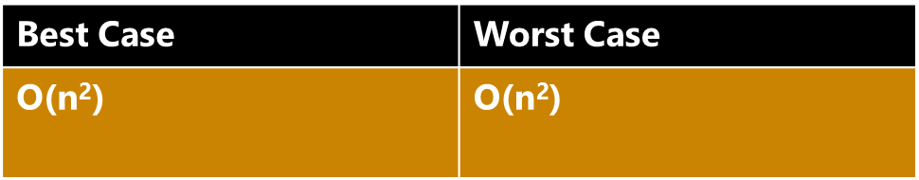
Bubble sort Algorithm
Bubble sort (A)
{
for (pass=1;pass<n;pass++)
for (c=1;c<=(n-pass);c++)
if (A[c]>A[c+1])
{
swap (A[c], A[c+1])
}
}

Slide 38
Selection sort Algorithm
Selection sort (A)
{
for (i=0;i<=n-1;i++)
{ min=i;
for (j=i+1;j<n;j++)
{
if (A[j]<A[min])
min=j;
}
swap (A[min],A[i])
}
}

Slide 39
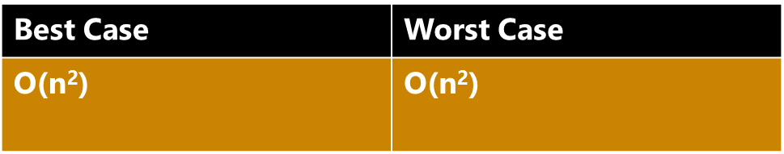
Insertion Sort Algorithm
Insertion sort (A)
{
for (i=1;i<n-1;i++)
{ key=A[i]
j=i-1;
while (j>=0 && A[j]>key)
{
A[j+1]=A[j];
j--;
}
A[j+1]=key;
}
}

Slide 40
Questions & answers

